Slide 1
Evaluation and Treatment of Sleep Challenges Among Individuals with Neurodevelopmental Differences
Laura Hiruma, PhD
Clinical Assistant Professor / Psychologist
UNC Carolina Institute for Developmental Disabilities
March 2021

Slide 2
Objectives
Participants will learn about:
The most common sleep challenges and reasons why individuals with neurodevelopmental conditions are at increased risk for such difficulties
Evaluation practices used to assess sleep disorders
Sleep hygiene recommendations, behavioral interventions, and other treatments for sleep-related challenges

Slide 3
Let’s Talk About Sleep Basics

Slide 4
Significance of Sleep
Emotional Distress
Cognitive
Dysfunction
Behavioral Challenges
Health & Immunity
Sleep Problems

Slide 5
Mechanics of Sleep
Sleep Cycles
90 mins on average in adults
60 minutes on average in young children
Five Stages of Sleep:
Stage 1: light sleep, drifting
Stage 2: brain wave slowing
Stage 3: Start of restorative deep sleep, slowed delta waves
Stage 4: Continued restorative deep sleep, mostly delta waves, refreshing
REM: Active/dream stage (20% of sleep time; 50% for babies)
https://www.ninds.nih.gov/Disorders/Patient-Caregiver-Education/Understanding-Sleep

Slide 6
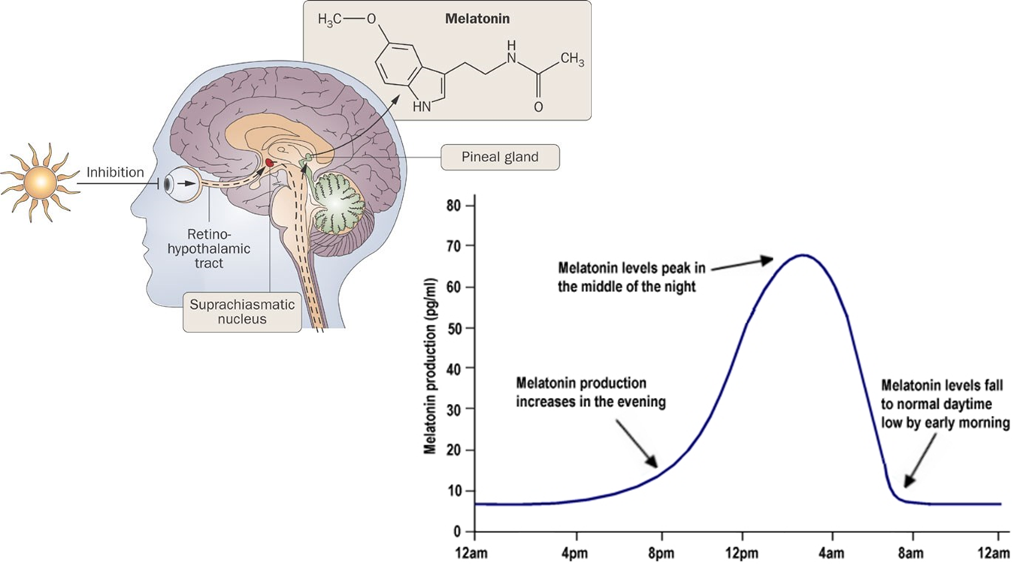
Mechanics of Sleep
Circadian Rhythm
“Internal clock”
Hormones/Cues
Light suppresses melatonin production during the day
Homeostatic Sleep Drive
Building need to sleep during periods of wakefulness
Bubenik, G. A. J. Physiol. Pharmacol. 58 (Suppl. 6), 23–52 (2007).
https://www.howsleepworks.com/images/melatonin.jpg

Slide 7
How much sleep should I be getting?
https://www.sleepfoundation.org/how-sleep-works/how-much-sleep-do-we-really-need

Slide 8
When Sleep Becomes a Challenge

Slide 9
What do we mean by sleep disturbance?
Sleep-Wake Disorders in DSM-5:
Dyssomnias: difficulty initiating or maintaining sleep, excessive daytime sleepiness
Insomnia
Hypersomnia
Circadian rhythm problems
Breathing-related disorders
Narcolepsy
Restless legs syndrome
Parasomnias: disruption of sleep states, abnormal sleep behaviors
Sleep bruxism
Sleep enuresis
Sleep walking
Night terrors
Ultimately,
is sleep a significant problem,
and is it causing distress and/or functional impairment?

Slide 10
Causes of Sleep Problems
Multiple, intertwined factors include differences in:
Genetics (e.g., family history, genes affecting sleep-promoting neurotransmitters)
Neurological features (e.g., differences in GABA neurotransmitter activity)
Physical factors (e.g., medical issues, muscle tone, hormones)
Sensory processing (e.g., auditory filtering, aversions)
Behavioral and psychiatric factors (e.g., behavior and emotion regulation, anxiety)
Developmental changes (sleep as a developmental skill and “moving target”)

Slide 11
Causes of Sleep Problems
Additional contributing factors (points of intervention):
Consistency of bedtime and sleep routines
Consistency of wake times and waking routines
Daytime activity and sleep
Diet and nutrition factors (e.g., iron, magnesium)
Sleep learning (sleep associations)
Sleep environment

Slide 12
Sleep Disturbance is Common
Sleep problems reported among typically developing youth:
Preschool children: 20-30%
School-age children: 25-40%
Adolescents: 17-33%
Owens JA. (2005). Epidemiology of sleep disorders during childhood. In: Sheldon SH, Ferber R, Kryger MH, editors. Principles and practices of pediatric sleep medicine.
Philadelphia: Elsevier Saunders; p. 27–33.

Slide 13
…and even more common for some
Higher occurrence of sleep disorders among individuals with:
Neurodevelopmental conditions such as autism and intellectual disability
Neurogenetic conditions such as Down syndrome, Prader-Willi syndrome, Angelman syndrome, and Smith-Magenis syndrome
Neurological conditions including cerebral palsy and epilepsy
Medical issues like gastroesophageal reflux disease (GERD) and chronic pain
Psychiatric conditions including depressive and anxiety disorders
Sensory impairments such as blindness

Slide 14
Down Syndrome
Down syndrome is a genetic condition in which a person has an extra copy of chromosome 21. Individuals present with characteristic facial features, intellectual disability, and low muscle tone in infancy. Some individuals have heart defects and other medical issues.
Sleep disturbance: around 50% of youth
Sleep-disordered breathing: one study found this in 68% of youth
Sleep disturbance patterns include sleep-disordered breathing (sleep apnea), daytime fatigue, insomnia, nighttime awakenings, parasomnias, restless sleep
Contributing factors include physical differences (low muscle tone, midline airway differences, enlarged tongue), hypothyroidism, GERD
Carter et al. (2009). Sleep problems in a Down syndrome population. Arch Dis Child, 94, 308-310.
Nehme J et al. Pediatr Pulmonol. 2019 Jun 6. doi: 10.1002/ppul.24380.

Slide 15
Autism
Autism spectrum disorder is a neurodevelopmental condition characterized by social learning differences and behavior patterns such as repetitive actions/speech, sensory processing disturbances, restricted interests, and preference for sameness.
Prevalence of sleep disturbance: 44-83%
Sleep disturbance patterns include irregular sleep/wake patterns, insomnia, decreased total sleep time, restless sleep, reduced REM sleep, nighttime awakenings, early morning waking, daytime fatigue
Contributing factors include sensory sensitivities, GI issues, increased anxiety/emotion regulation difficulties, co-occurrence of ADHD features (and psychostimulant use), possible genetic differences affecting sleep-wake cycles/melatonin production
Williams et al. (2004). Sleep problems in children with autism. Journal of Sleep Research, 13, 265-268.
Devnani & Hedge. (2015). Autism and sleep disorders. Journal of Pediatric Neurosciences, 10, 304-307.
https://www.spectrumnews.org/news/sleep-problems-autism-explained/

Slide 16
Cerebral Palsy
Cerebral palsy is a group of disorders affecting movement, balance, and posture caused by disruption in brain development, and is the most common motor disability among youth.
Prevalence of sleep disturbance: 23-46%
Sleep disturbance patterns included difficulty initiating sleep, breathing-related sleep disorder (e.g., sleep apnea), excessive daytime fatigue, involuntary movements, nighttime awakenings
Contributing factors include melatonin disruption (higher daytime levels and lower nighttime levels), low muscle tone, excessive drooling, gastroesophageal reflux disorder (GERD), muscle spasticity, pain, skin ulcers, constipation, seizures
Newman et al. (2006). Sleep disorders in children with cerebral palsy. Developmental Medicine and Child Neurology, 48, 564–568.
Santos et al. (2018). Day/night melatonin content in cerebral palsy. Neurosci Lett, 1, 23-27.

Slide 17
Prader-Willi Syndrome
Prader-Willi syndrome (PWS) is a genetic condition affecting a region of chromosome 15 characterized by hypothalamic dysfunction and associated endocrine dysfunction and hyperphagia. Individuals often present with cognitive delays and behavior concerns surrounding food seeking and compulsions.
Prevalence of sleep disturbance: some studies note rates up to 33-67%
Sleep disturbance patterns include sleep disordered breathing (sleep apnea), excessive daytime fatigue (narcolepsy-like features), reduced REM sleep
Contributing factors include differences in hypothalamic system affecting breathing during sleep, reduced sleep promoting hormones, weight gain
Maas et al. (2010). Sleep disturbances and behavioural problems in adults with PWS. Journal of Intellectual Disability Research, 54, 906-917.
Cataldi et al. (2021). Sleep disorders in PWS, evidence from animal models and humas. Sleep Medicine Reviews, 57, 101432.

Slide 18
Sleep Disturbances within I/DD Populations
Most relevant sleep problems across populations:
Sleep onset issues (insomnia, sleep onset association, limit-setting difficulties)
Sleep maintenance issues (nighttime awakenings)
Erratic/atypical sleep patterns (circadian rhythm problems)
Breathing-related (sleep apnea)

Slide 19
Behavioral Insomnia
Sleep onset association type:
Does falling asleep require an extended process that requires special conditions?
Are the conditions needed for sleep problematic or overly demanding?
In the absence of the associated conditions, is sleep onset significantly delayed/disrupted?
Do nighttime awakenings require caregiver intervention for the individual to return to sleep?
Limit-setting type includes each of the following:
Does the individual stalls or refuses to go to bed at an appropriate time?
Does the individual refuse to return to bed following a nighttime awakening?
Does the caregiver have difficulty establishing limits and enforcing routines surrounding sleep?
American Academy of Sleep Medicine (2005)

Slide 20
Evaluating Sleep Concerns

Slide 21
Practice Guidelines (for ASD)
Screen all youth for insomnia/sleep difficulties
Screen for potential contributing factors/medical issues
Determine need for therapeutic intervention
First line: education and behavior strategies
Assess indication for pharmacological therapy
Follow-up to evaluate effectiveness and tolerance of interventions
Malow et al., 2012

Slide 22
Screening and Assessment
Clinical interview/sleep history
Sleep questionnaires (e.g., PSQI, PSQ, BEDS)
Sleep diaries (parent-report, self-report)
Actigraphy
Polysomnography (PSG)

Slide 23
Sleep Interviewing and History
1. Sleep schedule and routines:
Sleep schedule (bedtime, wake times, naps across week)
Evening and bedtime routines
Waking and morning routines (mode of waking, difficulty getting up)
Timing of naps and routines
Are any support strategies used? (comfort items, visuals, rewards, etc.)
Sleep environment (setting, who/what is present during sleep onset)
Average time of sleep onset latency (subjective estimate)
Strategies for falling asleep, attitude towards sleep (anxiety)

Slide 24
Sleep Interviewing and History
2. Nature of sleep difficulties:
Difficulty falling asleep (classic or behavioral insomnia)
Circadian timing (when do you feel most alert versus most tired)
Restless legs syndrome (odd leg sensations, periodic limb movements)
Parasomnias (nightmares, night terrors, bruxism, enuresis)
Nighttime awakenings (when do these occur, how long, and how does the individual return to sleep—what are factors causing waking)
Sleep disordered breathing (any gasping, snoring, pauses in breath)
Narcolepsy symptoms (daytime sleepiness, cataplexy, hypnagogic hallucinations, sleep paralysis)
Duration of sleep problems, any recent contributing factors

Slide 25
Sleep Interviewing and History
3. Other considerations:
Medical history (GI issues, pain, seizures, medication use)
Family history of sleep disturbance
Developmental history (presence of delays, past sleep history)
Psychiatric history (mood-related symptoms)
Nutrition and diet (iron stores, magnesium levels)
Substances (caffeine intake, nicotine use)
Recent stressors/changes in routine
Current medications (antidepressants, decongestants, stimulants)
Participation in interventions (PT, OT, behavioral health intervention)
Past sleep interventions

Slide 26
Sleep Interviewing and History
4. Family-centered topics
Family priorities/goals for sleep difficulties
Intensity of intervention tolerated by individual/family
Co-sleeping/family sleeping arrangements
Consideration of treatment/support needs for daytime behaviors
Identification of sleep aids versus sleep crutches (subjective)

Slide 27
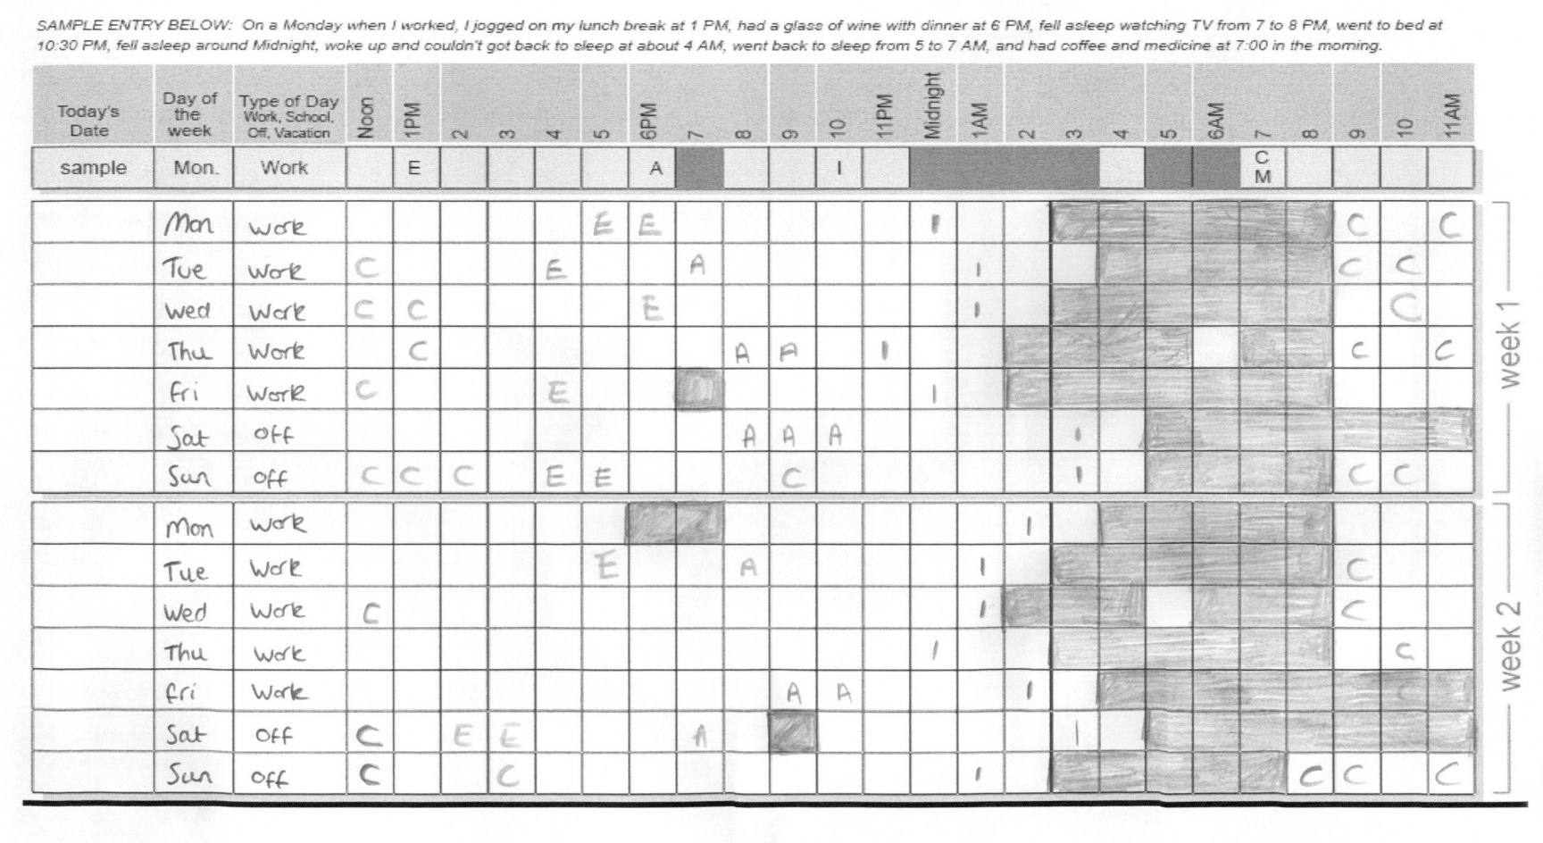
Sleep Diaries

Slide 28
Sleep Diaries
Problems with sleep diaries?
Can be subjective (individuals are asked to avoid watching the clock)
Younger children and some individuals with developmental disabilities may not be accurate reporters
Caregivers may not be aware of their family member’s sleep patterns throughout the night

Slide 29
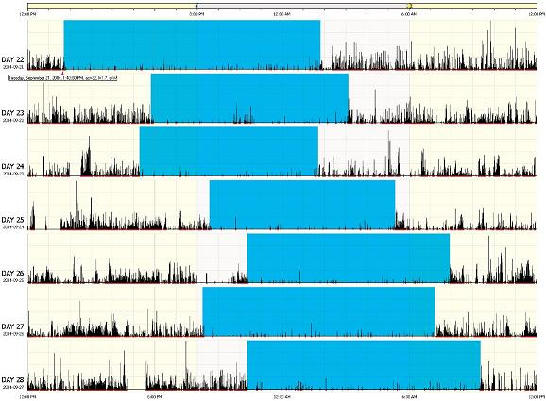
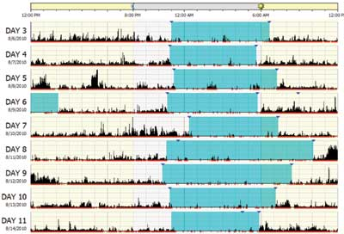
Actigraphy
Accelerometer measures movement to assess sleep-wake patterns (less accurate than PSG)
Easy to use, can record multiple nights of data
More affordable tool for researchers
Invasive for children
Insurance reimbursement varies (experimental method)

Slide 30
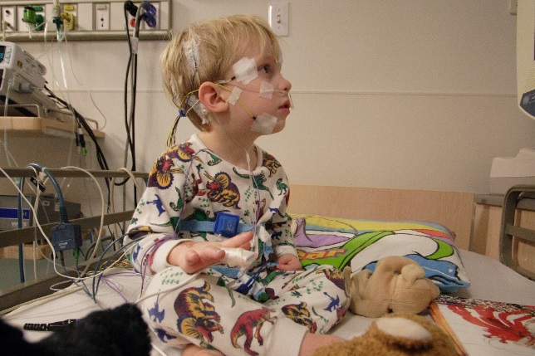
Polysomnography (PSG)
Gold standard tool for assessing sleep
Can assess physiological factors affecting sleep (e.g., apnea)
Typically done over night in lab-setting
Used when deemed medically necessary (not first line)
Can be invasive and difficult for individuals to tolerate
May not yield meaningful findings

Slide 31
Addressing Sleep Problems

Slide 32
Behavioral Sleep Interventions
Sleep hygiene strategies are the recommended first line intervention
The earlier, the better in terms of implementing approaches across development
Tried and true behavioral sleep training methods are effective for I/DD populations—the goal is to teach individuals the crucial skill of falling asleep independently
Appropriate to include extra accommodations, supports, safety measures
The family/individual should drive the approach (slow and gradual changes may work better for some individuals)
Consistency and planning are key
Beware of compensatory “sleep traps” when things go awry
Wholistic evaluation and care plan are ideal

Slide 33
Maintaining Good Sleep Hygiene
Consistent sleep/wake/nap schedules every day
Predictable sleep and wake routine/visuals/timers/consistent expectations
Environmental changes (comfort of room, limit light exposure, remove electronics, sensory needs)
Decrease nap time in older children
Avoid caffeine or stimulating activities prior to bed
Increase physical exercise during the day
Be proactive in addressing safety issues
Discuss potential medication side effects with prescribing physician

Slide 34
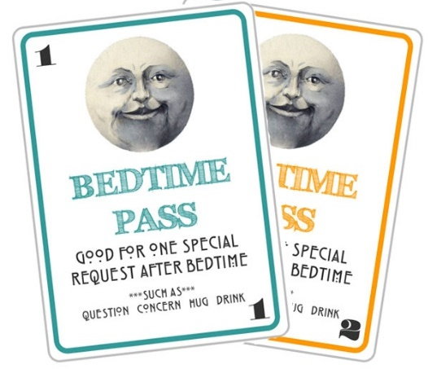
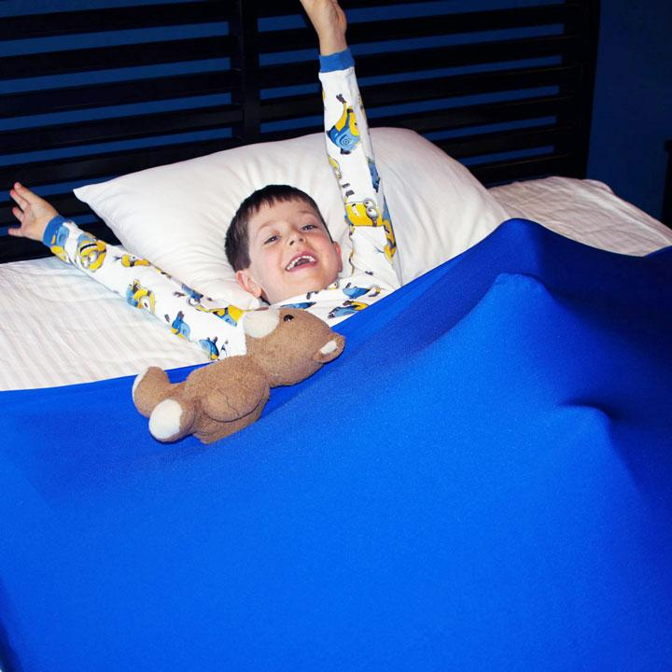
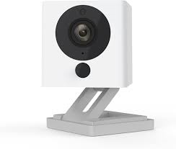
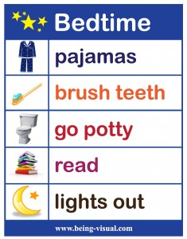
Behavioral Sleep Training
Develop or maintain good sleep hygiene measures
Develop productive bedtime routine (brief, directional, calming)
Consider methods for sleep training (teaching independent sleep)
Full extinction methods
Gradual fading procedures (check-in-check-out, move toward the door)
Create opportunities for the individual to fall asleep drowsy, but awake
Build in flexibility (e.g., alternate caregivers assisting with routine)
Proactive scheduled awakenings
Encourage use of transitional (comfort) objects, productive sleep aids
Fade use of sleep crutches (gradually disassociate these from sleep onset)
Use of reinforcement and rewards (e.g., bedtime passes, “sleep fairy”)
Behavior supports (visual schedules, transition cues such as timers)

Slide 35
Additional Considerations
The order of operations matters:
Prepare for/address any safety concerns first
Address environmental factors that are more easily resolved prior to sleep training
Determine targeted sleep and wake schedules
Focus on increasing more independent sleep initiation skills
Generalize sleep skills to nighttime awakenings (and naps, if applicable)
Data can be helpful to identify whether or not the intervention is working
Determine length of appropriate trial for intervention

Slide 36
Cognitive-Behavioral Interventions for Insomnia
Spielman’s 3-P Model of Insomnia:
predisposing factors (biological, personality)
precipitating events (stressful or disruptive events to sleep routine)
perpetuating mechanisms (anxiety, daytime napping, negative sleep associations)
Goal is to increase sleep efficiency (SE) gradually, so you might initially decrease time spent in bed:
SE = (time sleeping / time in bed) x 100%
Cognitive and behavioral strategies are used to address sleep-related anxiety and difficulties with sleep onset

Slide 37
Cognitive-Behavioral Interventions for Insomnia
Select routine sleep and wake times based on general sleep drive
Stimulus control (the bed is a place for sleeping): for trouble falling asleep, get out of bed and engage in relaxing activity until tired
Environmental control (limit exposure to bright lights in the evening, room temperature should be cool at night)
Avoid misguided compensatory strategies (avoid daytime napping, caffeine intake, or alcohol use)
Can track sleep progress, but avoid “clock watching”
Practice relaxation strategies at bedtime
Practice anxiety management strategies at other times (worry log, thought record)

Slide 38
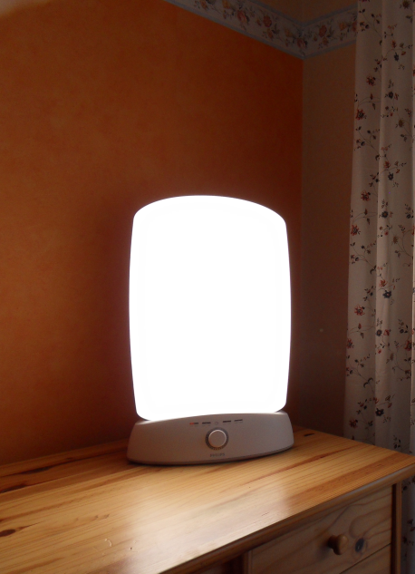
Interventions for Circadian Rhythm Problems
Chronotherapy (resetting/shifting internal clock)
Melatonin
Light Therapy (light box, dawn simulator)

Slide 39
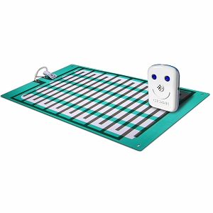
Addressing Nighttime Toileting Concerns
Consider bedtime toileting routine
Use of appropriate wear (nighttime pull-ups)
Continence training (e.g., bed-wetting alarm)
Proactively treat constipation
Prevent behaviors interfering with sleep
http://bedwettingstore.com/
https://preventawear.com/

Slide 40
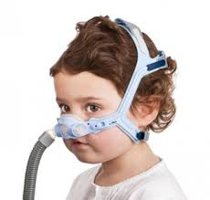
Medical Interventions
Medications to treat sleep disruption (clonidine, gabapentin, etc.)
Melatonin supplement (liquid and pill forms)
Iron therapy to treat restlessness and parasomnias (increase levels of serum ferritin; monitor constipation side effects)
Continuous positive airway pressure (CPAP) devices (sometimes require habituation training and compliance intervention)
Adenotonsillectomy for certain types of sleep apnea (not a cure-all for sleep difficulties)
Dental appliances, weight-reduction strategies, nasal steroids, and oral leukotriene modifiers may be considered as adjunctive treatments for sleep-disordered breathing

Slide 41
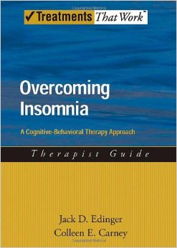
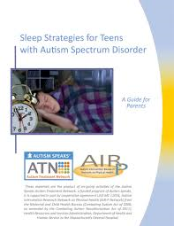
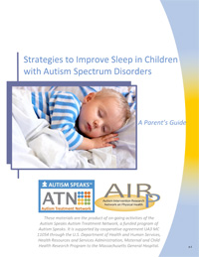
Resources
The National Sleep Foundation (https://www.thensf.org/)
Overcoming Insomnia by Jack Edinger & Colleen Carney
Sleeping Through the Night by Jodi Mindell
ATN’s Strategies to Improve Sleep in Children with Autism: A Parent’s Guide and ATN’s Sleep Strategies for Teens with Autism : A Parent’s Guide
American Sleep Apnea Association (https://www.sleepapnea.org/)
The American Sleep Association (www.sleepassociation.org)

Slide 42
Questions?

